Slide 1
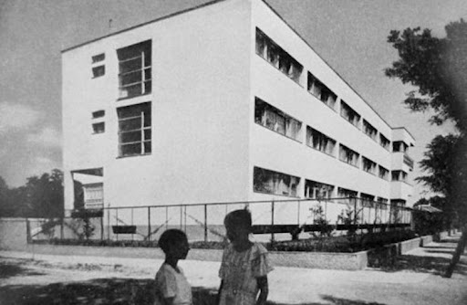
Housing finance beyond individual mortgages – Potential financial mechanisms for new forms of affordable housing in Eastern Europe
Zsuzsanna Pósfai
Periféria Policy and Research Center
Urban Movements and Local Politics in CEE countries: Recent Developments and Conceptual Ambivalences
Prague, 11.4. - 6.2021.

Slide 2
Disclaimers
work in progress
previous work on the inequalities inherent to housing finance + on mortgages and household debt
now conceptualizing and practically understanding how housing finance in Eastern Europe could be more progressive
policy and organizing work – how to develop and finance new housing forms?
more practice- than theory-based
negotiating financial mechanisms for housing cooperatives in Hungary
work done in MOBA Housing Network, which aspires to become a financial intermediary for new cooperative housing initiatives in the Eastern and South-Eastern European region

Slide 3
Context: Eastern European dependent housing finance, volatile housing markets
volatility of finance: an inherent characteristic of semi-peripheral, dependent housing markets » expectations of faster and higher returns; less commitment of foreign financial actors » integration of housing finance tools in the broader economic context
this results in volatile housing markets – unpredictable for households, and increasingly unaffordable » volatility creates house price shocks
alternation of periods of capital flowing abundantly onto the housing market and periods of lack of housing finance » the lack of stability conditions the strategies of all actors (financiers, developers, individuals)
could new forms of housing tenure, new institutions bring stability?

Slide 4
Limits to individual mortgages
Regulatory caps on mortgage lending (in HU):
max PTI – 50% if min 10 year mortgage (otherwise lower)
max LTV – 80% but often lower (most often 30-40% equity required)
To be proven by formal income
In the practice of banks:
Employment status (indeterminate contracts required)
Demographic characteristics (age, children, etc)
Spatial aspects (differences of real estate market)
Generally more risk aversion since the crisis
Obstacles to households:
Existing previous loan
High downpayment
»» techniques for increasing the market of mortgages (after 2015):
- state subsidies for those who are on the limit of accessing market-based mortgages
- increasing loan amounts for those who are eligible
»» mortgages still not affordable / accessible to many
(current crisis aggravates that)

Slide 5
Missing forms of housing finance
patient finance (long term, low interest rates)
long-term housing-purpose funding to organizations / non-profit corporations
»» characteristics of semi-peripheral / dependent economies
What would be the benefit of creating such financial instruments?
opening the potential for new housing tenure forms to develop
access to stable and affordable housing for those who cannot access either the market or the small public housing stock in Eastern Europe

Slide 6
Housing finance as an enabler for new housing institutions
institutionally owned affordable rental housing („housing associations”)
do not exist in the region
access to long-term affordable loans is a prerequisite to their existence (currently accessible: max 10-15 years)
private rental market dominated by small private landlords – difficulty to regulate
housing cooperatives
only ownership-based cooperatives exist in the region (except Poland)
in order to provide access to those who cannot become individual owners – loans taken by the cooperative have to be made possible
»» other conditions also need to be in place, but the development of adequate financial tools is fundamental
»» thinking of financial instruments as enablers of new institutions and progressive solutions rather than merely as forms of investment

Slide 7
Potential financial mechanisms
government (subsidies and) loan-based instruments (eg. through national development banks)
EU loan-based instruments
bottom-up, self-managed funds
community financing

Slide 8
EU loan-based financial instruments » Potentials and difficulties
difficult to get around the scale of the nation state
developing the capacities of housing organizations
reducing the minimum loan package (smaller projects)
financial intermediaries to be trained about the specifics of housing finance

Slide 9
Bottom-up, self-managed funds » The starting experience of the MOBA Fund
https://moba.coop/2021/05/24/moba-housing-development-fund-launch/

Slide 10
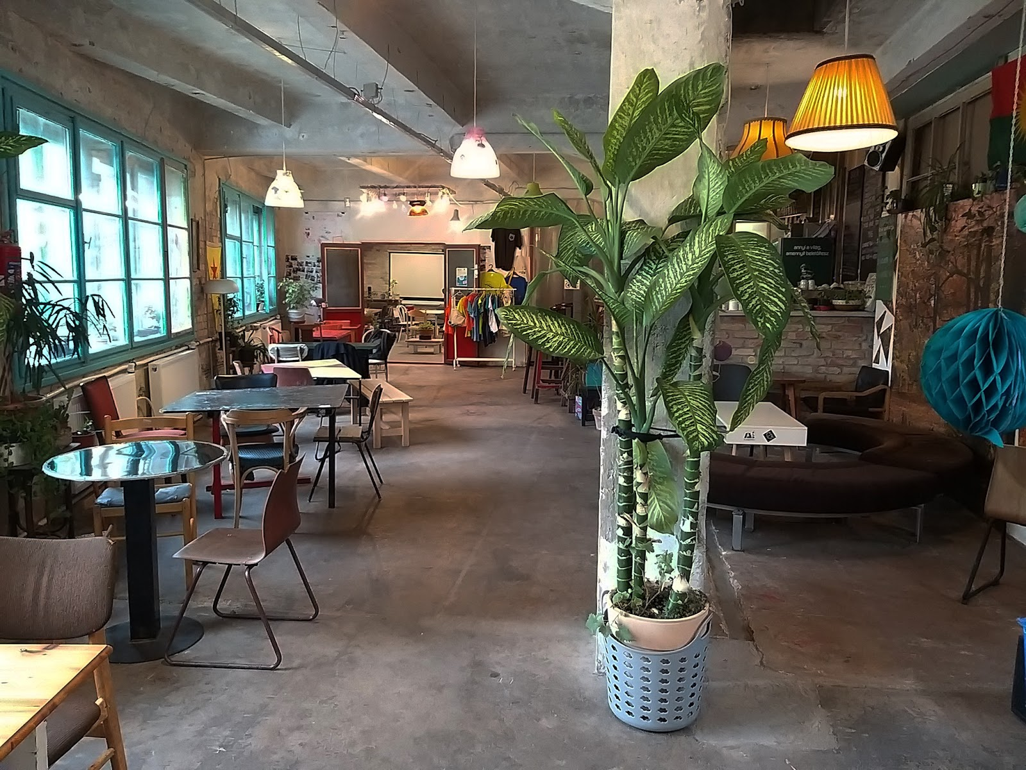
Community financing » Making an asset out of necessity
2 Budapest examples:
Zugló Collective House Association, Gólya Cooperative
Different forms of community financing:
P2P lending
lending to organizations / projects by various individuals
investment-based
Issues it can respond to:
lack of equity – can substitute, but becomes expensive
lack of long-term finance – lengthening through community financing, but constant pressure of refinancing
potential of community-building through financial involvement

Slide 11
Overcoming bottlenecks
Role of the state
developing the regulatory framework of rental housing and rental-based cooperative housing
shifting the focus of government subsidies away from individual homeownership
developing own financial mechanisms and guarantee mechanisms
Role of market actors
developing different methods of risk assessment
allocating resources to new product development
developing partnerships and communication with both public entities and housing organizations
accepting longer returns on investment
Role of housing organizations
building up capacities
developing proposals
reaching out to the target group

Slide 12
Financial innovation needed for affordable housing
What would this practically mean
long-term loans that assess the cash-flow of housing organizations (and not individuals)
financing not-for-profit entities
making favorable financial instruments accessible to smaller actors
How to scale up beyond pilot projects?
identifying a large enough target group whose needs are not met under market conditions
securing stable financial channels
developing an enabling policy environment
developing the capacities of housing associations and cooperatives
The potential opportunity in the current moment
economic instability reduces individual access to mortgage
abundant liquidity on financial markets

Slide 13
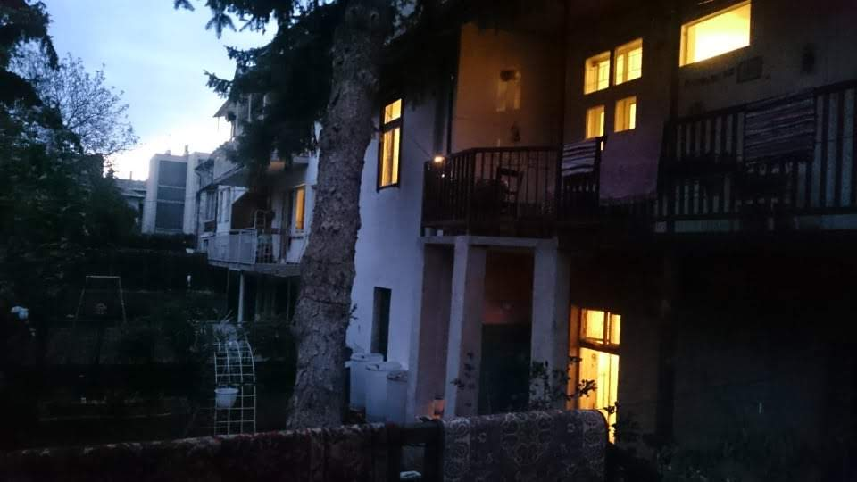
Thank you!
posfai.zsuzsanna@periferiakozpont.hu
www.periferiacenter.com

